Slide 1

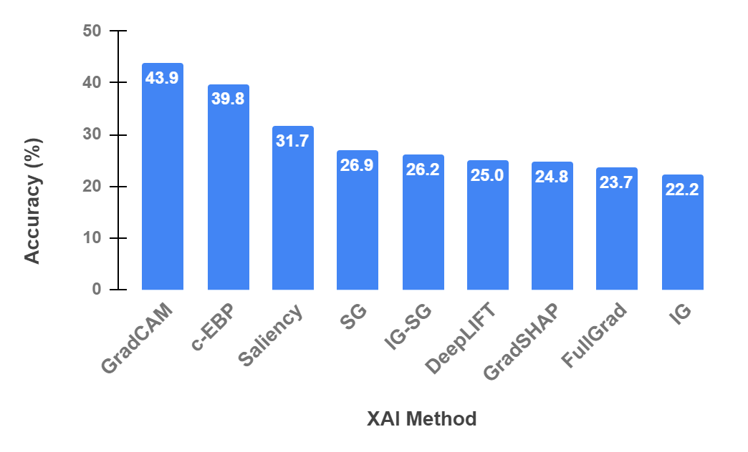
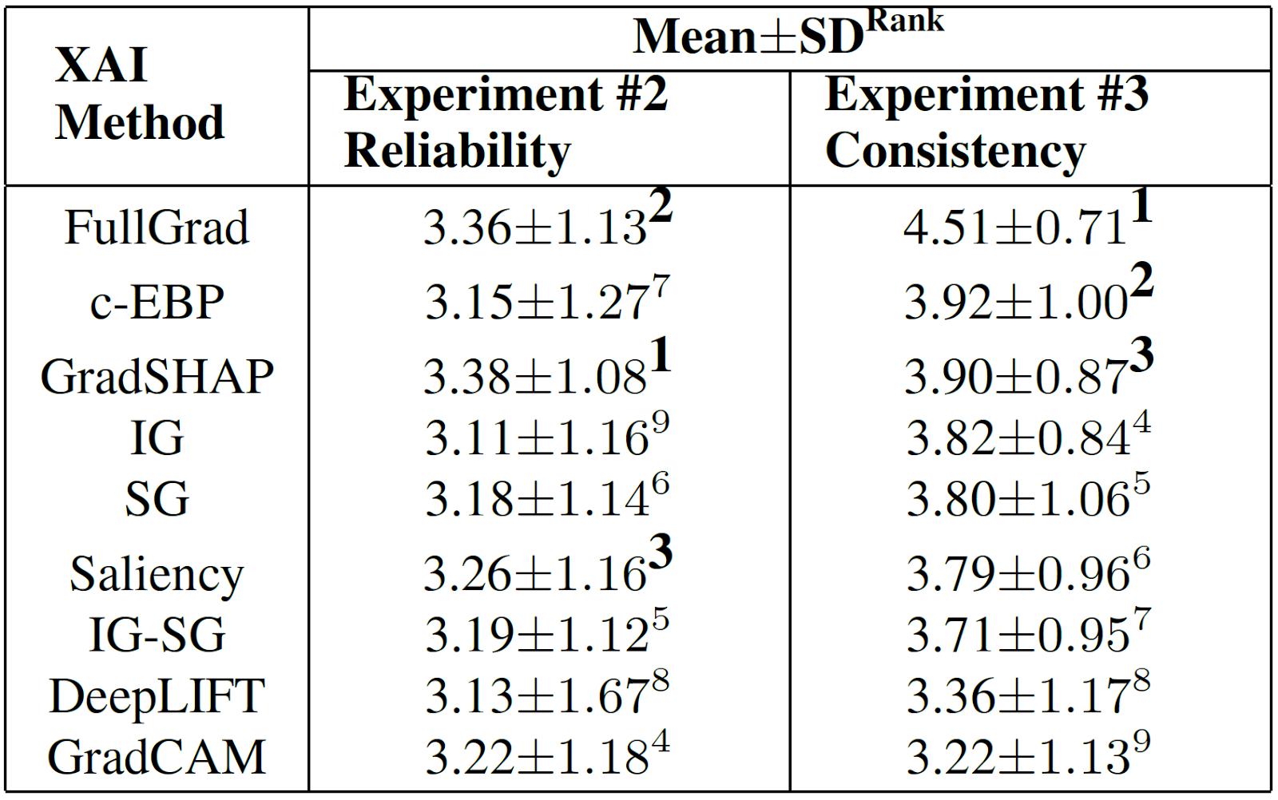
Evaluation of Saliency-based Explainability Methods
Sam Zabdiel Samuel, Vidhya Kamakshi, Namrata Lodhi, Narayanan C Krishnan
Indian Institute of Technology Ropar
Goal: Gauge effectiveness of saliency-based XAI methods
Human Subject Experiments
#1 Predictability
#2 Reliability
#3 Consistency
Accuracy for Experiment #1
GradientSHAP and FullGrad are effective!
FullGrad rated highly consistent!
Future: Human-centric approach to XAI
Likert value means and ranks

